Slide 1
Differences Between Behavioral and Mental Health Services
Lauren W. M. Swager MD
Adult, Child and Adolescent Psychiatrist

Slide 2
Objectives
Review of Intellectual and Developmental Disorder terminology and etiology
Understand how to assess behavior and etiology of behaviors
Review approaches to how to distinguish if behaviors are psychiatric or developmental in origin
Understand the co-morbidity of mental health disorders in developmental disabilities
Broaden treatment approaches to incorporate both behavioral and psychological/psychiatric treatments
Understand the limits of psychotropic medications and be mindful to dangers of prescribing medications for behaviors with developmental etiologies.

Slide 3
Terminology
DSM5 uses Intellectual Disability (Intellectual Developmental Delay)
A federal statute in the US (Rosa’s Law, Public Law 111-256) replaced the term mental retardation with intellectual disability
Previously established by AAMR in 1961 to replace other pejorative terms
ID/IDD is a term now common in medical, educational, other professions and lay and advocacy groups
Developmental Disability has also been used as a legal term with its own definition (related to physical/mental impairments in at least 3 major areas of life activity and starting before age 22)
“Person first” language- A person was an Intellectual/ Developmental Disability

Slide 4


Diagnostic Criteria for Intellectual Disabilities
1. Deficits in intellectual functioning
This includes various mental abilities:
    Reasoning;
    Problem solving;
    Planning;
    Abstract thinking;
    Judgment;
    Academic learning (ability to learn in school via traditional teaching methods);
    Experiential learning (the ability to learn through experience, trial and error, and observation).
These mental abilities are measured by IQ tests. A score of approximately two standard deviations below average represents a significant cognitive deficit. These scores would occur about 2.5% of the population. Or stated differently, 97.5% of people of the same age and culture would score higher. The tests used to measure IQ must be standardized and culturally appropriate. This is typically an IQ score of 70 or below.

Slide 5
Diagnostic Criteria for Intellectual Disabilities
2. Deficits or impairments in adaptive functioning
This includes skills needed to live in an independent and responsible manner. Limited abilities in these life skills make it difficult to achieve age-appropriate standards of behavior. Without these skills, a person needs additional supports to succeed at school, work, or independent life. Deficits in adaptive functioning are measured using standardized, culturally appropriate tests.
  Communication: This refers to the ability to convey information from one person to another. Communication is conveyed through words and actions. It involves the ability to understand others, and to express one's self through words or actions.
  Social skills: This refers to the ability to interact effectively with others. We usually take social skills for granted. However, these skills are critical for success in life. These skills include the ability to understand and comply with social rules, customs, and standards of public behavior. This intricate function requires the ability to process figurative language and detect unspoken cues such as body language.
  Personal independence at home or in community settings: This refers to the ability to take care of yourself. Some examples are bathing, dressing, and feeding. It also includes the ability to safely complete day-to-day tasks without guidance. Some examples are cooking, cleaning, and laundry. There are also routine activities performed in the community. This includes shopping for groceries, and accessing public transportation.
  School or work functioning: This refers to the ability to conform to the social standards at work or school. It includes the ability to learn new knowledge, skills, and abilities. Furthermore, people must apply this information in a practical, adaptive manner; without excessive direction or guidance.

Slide 6
Diagnostic Criteria for Intellectual Disabilities
3. These limitations occur during the developmental period. This means problems with intellectual or adaptive functioning were evident during childhood or adolescence.
If these problems began after this developmental period, the correct diagnosis would be neurocognitive disorder. For instance, a traumatic brain injury from a car accident could cause similar symptoms.

Slide 7
DSM5
In DSM5, severity specifiers are defined on the basis of adaptive functioning instead of IQ scores (in order to best determine level of support required)
Still mild, moderate, severe and profound
  Mild (Prev - IQ level 50-55 to approximately 70)
    Often acquire skills to about 6th grade level
    May live independently
  Moderate (Prev - IQ level 35-40 to 50-55)
    Can carry out work and self-care tasks with moderate supervision
    May live successfully in the community in supervised environments (group homes)
  Severe (Prev - IQ level 20-25 to 35-40)
    May master very basic self-care and some communication skills
    Able to live in group home, requiring more assistance
  Profound (Prev - IQ level under 20-25)
    Often caused by accompanying neurological disorder
    Requiring a high level of structure and supervision

Slide 8
Global Developmental Delay
Individuals under age 5
Failing to meet developmental milestones in several areas
Severity level cannot be reliably assessed.
Again, requires reassessment after a period of time.
Neurology has a more specific criteria
Delay (2 SD below mean) in 2 or more of the following:
Gross/fine motor, speech/language, cognition, social/personal, ADLs
Does not necessarily mean that the child will meet criteria for ID in the future

Slide 9
Etiology
Prenatal
  Genetic syndromes (sequence variations or copy number variants, chromosomal disorders)
  Brain malformations
  Maternal disease (including placental disease)
  Environmental (alcohol, other drugs, toxins, teratogens)

Slide 10
Etiology
Perinatal
  Neonatal encephalopathy resulting from a variety of labor and delivery-related events
  Risk factors: malnutrition, vitamin and mineral deficiency, placental insufficiency, in utero exposures, maternal illness
  Pre/Peri infections: toxo, syphilis, varicella, parvo, rubella, CMV, herpes
  Timing of environmental insult influences type/severity of impact
Postnatal
  Hypoxic ischemic injury
  Risk increases with prematurity, low birth weight, IC hemorrhage, hypoglycemia
  Later postnatal: TBI, infections (meningitis, encephalitis), demyelinating disorders, seizure disorders (eg. infantile spasms), severe and chronic social deprivation, and toxic metabolic syndrome and intoxications (eg. lead, mercury)

Slide 11
Why is etiology important?
Behavioral phenotypes
  “The heightened probability or likelihood that people with a given syndrome will exhibit certain behavioral and developmental sequelae relative to those without the syndrome” (Dykens, 1995, p.523)
  Prader-Willi and hyperphagia
  Lesch-Nyhan and compulsive Self-injury
Risk assessment
  Some ID-associated conditions are also known to predispose to certain general medical conditions that can influence behavior/emotions as well as overall health
  Velocardiofacial syndrome is a high-risk factor for schizophrenia
Treatment options will need to address all behavioral, mental health and physical health needs.

Slide 12
Differential Diagnoses
Neurocognitive disorders - a loss of cognitive functioning as opposed to developmental delay. If both occur in the same person (someone with Down Syndrome developing AD, someone with ID sustains a TBI), then both diagnoses should be given.
Communication and learning disorders - do not involve intellectual or adaptive deficits. These diagnoses may co-occur, and both should be given if all criteria met.
Autism Spectrum Disorders (ASD) – May co-occur. Social-communication deficits may lead to difficulties in obtaining accurate IQ testing, particularly in younger ages.
Other conditions that may impact performance on IQ testing
  Affective disorders, ADHD, psychosis, etc.

Slide 13
Be very careful of terminology
Behaviors need assessed for etiology.
If a behavior has not been appropriately assessed for etiology or development, there is a good likelihood the diagnosis could be WRONG or missing key understanding of cause.
If you see these psychiatric dx listed also make sure other developmental causes have not been missed.
  Aggression
  ADHD
  Reactive Attachment
  Oppositional Defiant Disorder
  Conduct Disorder
  Disorders of Sexual Behavior
  Intermittent Explosive Disorder
  Post Traumatic Stress Disorder/Hx of Abuse and Neglect
  Intellectual Disabilities/Borderline Intellectual Functioning

Slide 14
Developmental vs Psychological Causes of Behavior
Developmental
  Typically waxes and wanes with clear environmental changes and antecedents
  Clients understanding or process of environment or feelings triggered are due to their developmental level
  Behaviors are occurring because member has not learned a new way to handle or cope with environmental press which may be due to not having learned alternatives for their developmental level
  Unlikely to change with medications.
Psychiatric/Medical
  There is a clear underlying biological component medical or psychiatrically that needs treated to address behavior.
  Less likely to wax and wane or differ depending on environment and persistent across all environments.
  More likely to happen in episodes of several weeks/months duration.
  May change with medications.

Slide 15

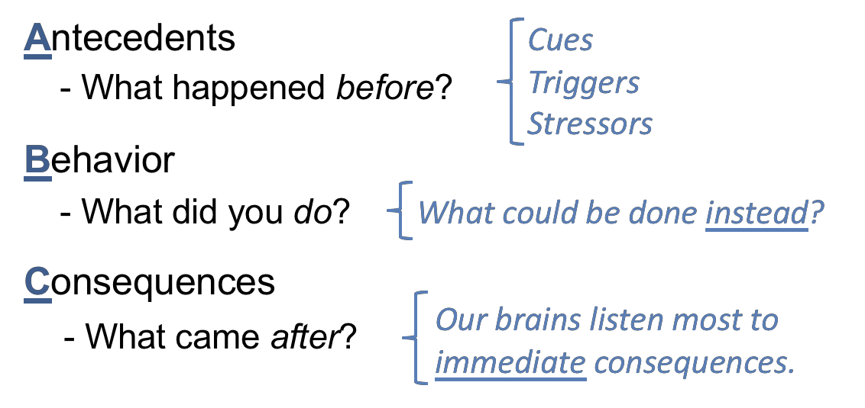
ABC’s of Understanding Behaviors

Slide 16
Factors Contributing to Behavioral Symptoms
Sensory deficits
Hearing/visual impairment- higher rates of anxiety and behavioral concerns
Motor impairment – higher rates of inattention and hyperactivity
Pain
Ear infections, headaches, menses, injuries, constipation, GERD, dental
Specific associations
Down Syndrome risk of thyroid, cardiac, vision and hearing problems
Metabolism, stress response, immune/inflammatory mechanisms of syndromes
Post-ictal (seizure) dysphoria, irritability, and/or behaviors (transient)
ADHD/Other disorders of impulse control
Frontal Lobe Injuries
Trauma Triggers /Hypervigilance
Psychosis

Slide 17
Factors Contributing to Behavioral Symptoms
Behavior
Functions of a behavior may maintain it
Escape
Gain attention/ access to preferred people/things
Internal reinforcement (self-stimulatory, pain-reducing)
May be inadvertently developed/maintained by environment
ABCs to assess
Communication
Inability to communicate can cause/exacerbate symptoms
Benefits of alternative or augmentative communication (AAC) methods

Slide 18
Comorbidities with psychiatric diagnoses are common
Comorbid mental, neurodevelopmental, medical and physical conditions are frequent, with some rates (mental disorders, CP, epilepsy) as high as 3-4x general population
Prevalence ranges for having an additional psychiatric disorder for mental disorders in ID range 30-70%.
Most common comorbid mental/neurodevelopmental disorders are:
  ODD-Oppositional Defiant Disorder
  ADHD – developmental course of ADHD similar to typically developing children, more hyperactivity
  Mood disorders – both unipolar and bipolar
  Anxiety disorders
  Autism Spectrum Disorders (ASDs)
  FASD (aka Neurodevelopmental Disorder-Prenatal Alcohol Exposure
  Stereotypic movement disorders – with and without SIB. Warrants a separate diagnosis if it is a focus of clinical attention.
  Impulse-control disorders
  Major neurocognitive disorders
  Disruptive behavior and aggression

Slide 19
Comorbidities
Other common associated disorders
  Seizures – 15-30% of severe or greater ID
  Motor handicaps – 20-30%
  Sensory impairments – 20%

Slide 20
Psychiatric Symptom Measures
Measures validated in youth with ID/IDD
  Self-report questionnaires unreliable
Broad Big 3
  Developmental Behavior Checklist (DBC)
    Teacher and Parent versions
  Nisonger Child Behavior Rating Form (NCBRF) – FREE ☺
    Teacher and Parent versions
    Not as much empirical support as the DBC
  Reiss Scales for Children’s Dual Diagnosis (RSCDD)
    Derived from the RSMB, which was empirically driven and developed from DSM-III-R taxonomy

Slide 21
Disorder Specific Screeners
Anxiety
DBC and NCBRF anxiety subscales
CBCL Anxious/Depressed subscale for mild IDD, but unable to separate out
Psychopathology Instrument for Mentally Retarded Adults (PRIMA) and CBCL have good convergent validity for anxiety/depression
Others
Diagnostic Manual – Intellectual Disability
Developed through expert consensus, discussing issues in applying DSM criteria to youth with ID-IDD
Aberrant Behavior Checklist
Good outcome measure to monitor treatment response
Measures hyperactivity, social withdrawal, lethargy, stereotypy, irritability

Slide 22
Functional Behavioral Assessments (FBA)
FBAs are rooted in the theory that behavior is functional (meaning it has a purpose), predictable and changeable.
FBAs may miss psychiatric/medical causes of behavior if not considered for behaviors that are not predictable or not responding to interventions/environments interventions
Components of an FBA- REMEMBER the ABCs
What the Challenging behavior is in observable and measurable terms, and where, when, and with whom the behavior occurs; •
what the antecedents are (what typically occurs before the behavior);
what consequences reinforce or maintain the behavior (what typically occurs after the behavior); •
what interventions and strategies have been tried previously and their effects; and •
what the setting events are (what makes the problem behavior worse or more likely to occur

Slide 23
Treatment – Community and Supportive Care
Community treatment includes
  Ongoing medical management of comorbid physical conditions
    Hypothyroidism
    Cataracts
    Heart defects
    Seizures
  Treatment of comorbid mental disorders
  Additional supports may include
    Physical therapy
    Occupational therapy
    Language therapies

Slide 24
Treatment – Communication Interventions
Alternative and assistive communication interventions (AAC)
Meta-analysis of AAC for challenging behavior (+/- ASD) = effect size 0.88
Functional Communication Training (FCT)
Children trained to initiate communication with specific communication strategies to replace problem behaviors that serve the same function
Studies showing higher effect sizes
Teaching theory of mind skills
Little evidence of ability to generalize skills or maintain across time/settings

Slide 25
Treatment – Behavioral Intervention Plans (BIPs)
Well-studied and widely used for maladaptive functional behaviors in context of intellectual disability
  Deohring et al study of ABA for youth 6-18 with ID/IDD effective for behavioral problems in 91%
  Includes: increasing adaptive/communication/social skills, antecedent interventions, reinforcement strategies, FCT, extinction procedures

Slide 26
Behavioral Intervention Plans
The essential components of a BIP are as follows:
    a detailed description of the behavior;
    summary statement describing the function of the behavior;
    interventions used and their results;
    behavioral goals;
    plan for teaching the client and supporting the new behavior, including a crisis intervention plan (if needed);
    description of success (criteria and consequences);
    how fidelity of the plan will be measured; and
    follow-up activities.
    Must adapt and change when behaviors change or the antecedents or etiology changes

Slide 27
Behavioral Interventions
Behavior enhancement (accelerating) procedures
Differential reinforcement of incompatible behaviors
Behavior reduction (decelerating) procedures
Used in combination with differential reinforcement, and positive reinforcement given if undesired behavior is not exhibited in a predetermined interval
Positive Behavioral Support plan for the behaviors you want to see are typically most effective.
Positive punishment has been used
Verbal reprimand, ammonia capsules, mist spray
Short-term efficacy, questionable generalizability, criticized
Typically reserved for the most dangerous behaviors
Rarely used

Slide 28
Treatment – Behavioral Emergencies
Safety first
  If redirection fails, physical restraint may be necessary and emergency medication considered
  If using a medication, if possible, use a medication with which the patient previously had a positive experience, typically a neuroleptic or benzo at the smallest effective dose.
After establishment of safety emergencies prompt a comprehensive diagnostic assessment including evaluation of environmental influences.
Consider medical causes for behavior. Constipation, infection, occult injury
Consider medication side effects

Slide 29
Treatment - Pharmacotherapy
“start low, go slow”
Have awareness of population-specific effects
  In Down Syndrome, patients may be sensitive to anticholinergics
  In all ID, patients may be disinhibited by sedative-hypnotics
  ID/DD Population at large more sensitive to adverse effects
  Reassess meds and etiology when it is not helping.
  Medication use must be parried with effective behavioral data to assess if it helps
  SEDATION is not a goal of daily pharmacotherapy

Slide 30
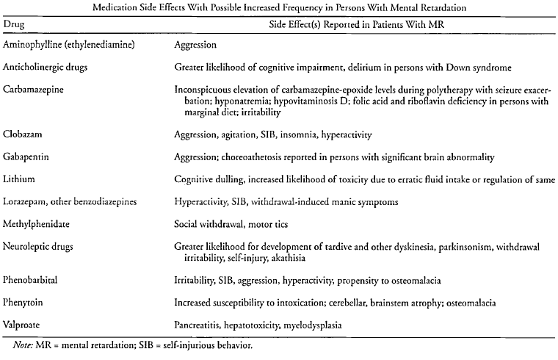
Medications CAN cause behavioral symptoms:
Be Mindful the Medication you thought could help may be the cause

Slide 31
Many Pitfalls of Pharmacotherapy
Prescribing medications with inadequate information about the target symptoms
Prescribing without consideration of potential adverse effects on daily functioning or quality of life
Improper informed consent
Medication decisions are not integrated as part of a comprehensive treatment plan
No behavioral data collected
No behavioral intervention
No communication with therapists
No monitoring for adverse effects

Slide 32
Many Pitfalls of Pharmacotherapy
Medications prescribed are excessive or poorly justified
Using medications when behavioral interventions are indicated
Multiple medications from the same class
Medication at excessive dosages
Medications used for nonspecific indications-” mood, aggression, irritability” are common examples of nonspecific terms
Medication usage for extended periods of time with no attempt to adjust doses or documentation of ongoing need for treatment
Medications continued despite no establishment of treatment effectiveness
Medications prescribed for the convenience of caregivers or as a substitute for appropriate services
Medications may be sought to increase patient compliance in a setting which may not be appropriate for that individual’s cognitive/adaptive level (and thus anxiety-provoking)

Slide 33
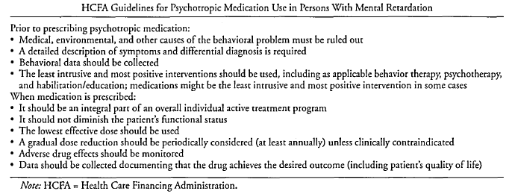
Medication Guidelines

Slide 34
ECHO Case Presentation
Elma Fisher, MEd.​
HealthWays

Slide 35
Background on Case
33-year-old male
Middle child
Older brother younger sister
Parents still married
Did well in school academically
Sinus and stomach issues otherwise healthy

Slide 36
Background on Case
Diagnosis:
Autism Spectrum Disorder
Schizophrenia

Slide 37
Background on case
Socially awkward
No friends
No job
Was living with parents
Individuals did not think he could have Schizophrenia and Autism
  ~30% of children and adolescents with COS have co-morbid ASD

Slide 38
Goals and Barriers
Goals:
To keep from self harming
Live on his own
Develop friendships
Barriers:
social and communication deficits
treating the mental health disorder.

Slide 39
Community Discussion
What areas or domains of functioning would you seek assistance for with this case?
  Communication; social skills; personal independence at home or community setting; school or work functioning
  What are the ABC’s of his behavior
    Antecedents
    Behavior
    Consequences
What portions/behaviors would be associated with his ASD? Schizophrenia? How would you find out?
Why do you think knowing more about how ASD and schizophrenia interact is important?
What would we want to include for the functional behavioral assessment (FBA) and behavioral plan?

Slide 40
Outcome
The patient is 40 years old now and I hear he is doing very well. He lives on his own, holds down a job, and has not self-harmed. He also has some friends. He is on the right medication for him and he is doing well.

Slide 41
Wrap Up/ Close Out
Autism and Schizophrenia occur more than anyone first thought.
Meet the person where they are.
Deal with the symptoms.
Think outside of the box for new ideas to help clients.
Notes:
Include strategies and interventions you used, how the patient responded, and any ongoing treatment, maintenance, or goals for the future.

Slide 42

Questions….

Slide 43
References
A special thank you to Dr. Bridget Skidmore, WVU Behavioral Medicine and Psychiatry. I adapted most of my slides from a previous lecture she provided me.
Practice Parameter for the Assessment and Treatment of Psychiatric Disorders in Children and Adolescents With Intellectual Disability (Intellectual Developmental Disorder). (2020) Journal of the American Academy of Child & Adolescent Psychiatry, 59(4):468–496
Baer, D.M., Wolf, M.M., & Risley, T.R. (1968). "Some current dimensions of applied behavior analysis.". Journal of Applied Behavior Analysis 1: 91–97.doi:10.1901/jaba.1968.1-91. PMC 1310980.
Daroff, R. (2012). Bradley's neurology in clinical practice (6th ed.). Philadelphia, PA: Elsevier/Saunders.
Diagnostic and statistical manual of mental disorders: DSM-5. (5th ed.). (2013). Washington, D.C.: American Psychiatric Association.
Dosen, A. (2001). Treating mental illness and behavior disorders in children and adults with mental retardation. Washington, DC: American Psychiatric Press.
Dykens EM (1995). Measuring behavioral phenotypes: provocations from the "new genetics." Am]Ment Retard99:522-532
Harris, J. (2006). Family, Psychoeducational, Behavioral, Interpersonal, and Pharmacologic Interventions. In Intellectual disability understanding its development, causes, classification, evaluation, and treatment. New York: Oxford University Press.
Michelson, D., Shevell, M., Sherr, E., Moeschler, J., Gropman, A., & Ashwal, S. (2011). Evidence Report: Genetic and metabolic testing on children with global developmental delay: Report of the Quality Standards Subcommittee of the American Academy of Neurology and the Practice Committee of the Child Neurology Society. Neurology, 1629-1635.
Satya-Murti, S., Cohen, B., & Michelson, D. (2013, August 20). Chromosomal Microarray Analysis for Intellectual Disabilities. Retrieved February 15, 2015.
Shevell, M., Ashwal, S., Donley, D., Flint, J., Gingold, M., Hirtz, D., ... Sheth, R. (n.d.). Practice parameter: Evaluation of the child with global developmental delay: Report of the Quality Standards Subcommittee of the American Academy of Neurology and The Practice Committee of the Child Neurology Society. Neurology, 367-380.

